Slide 1
Bit Addresses
For I/O and RAM

Slide 2
7FH
General Purpose RAM
Bit Addressable Locations
BANK 3
BANK 2
BANK 1
BANK 0
30H
2FH
20H
1FH
00H

Slide 3
2F
27
20

Slide 4
2F
7F | 78 | 7D | 7C | 7B | 7A | 79 | 78
27
3F | 3E | 3D | 3C | 3B | 3A | 39 | 38
20
07 | 06 | 05 | 04 | 03 | 02 | 01 | 00

Slide 5
2E
77 | 76 | 75 | 74 | 73 | 72 | 71 | 70
26
37 | 36 | 35 | 34 | 33 | 32 | 31 | 30
21
0F | 0E | 0D | 0C | 0B | 0A | 09 | 08

Slide 6
Single Bit Instructions
SETB bit Set the bit (bit = 1)
SETB 42H ; set bit 42H to 1

Slide 7
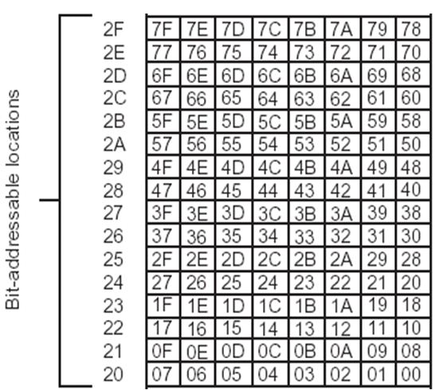

Slide 8
Single Bit Instructions
CLR bit Clear the bit (bit = 0)
CLR 67H ; clear bit 67

Slide 10
Single Bit Instructions
CPL bit
Complement the (bit = NOT bit)
CPL 0FH ; complem. bit 0F

Slide 12
Single Bit Instructions
JB bit, target
Jump to target if bit = 1 (jump if bit)
JB 28H,LOOP ; jump if 28H = 1

Slide 14
Single Bit Instructions
JNB bit, target
Jump to target if bit = 0 (jump if no bit)
JNB 12,LOOP ;jump if bit 12 = 0

Slide 16
Single Bit Instructions
JBC bit, target
Jump to target if bit = 1 (jump if bit, then clear)
JBC 5,LOOP ;jump if bit 5 = 1,
;and clear bit 5

Slide 18
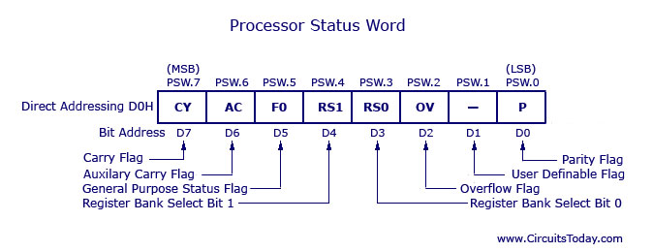

Slide 19
PSW bit addressability
Syntax
BIT instruction PSW.Bit number
SETB PSW.3 ;set the 3 bit

Slide 20
PSW bit addressability
Write a program to save the accumulator in R7 of bank 2

Slide 21
PSW bit addressability
CLR PSW.3
SETB PSW.4
MOV R7, A

Slide 22
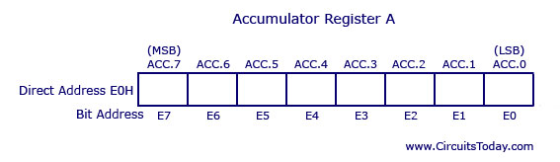

Slide 23
Accumulator bit address.
Write a program to see if the RAM location 37H contains an even value. If yes, jump to location “YES”

Slide 24
Accumulator bit address.
MOV A, 37H
JNB ACC.0, YES

Slide 25
